Slide 1
Workday Community Information Session 1/25/22

Slide 2
Agenda
What is Workday?
Workday at UCF: Demonstration
Workday by Role
Training Update
Welcome
Get Involved

Slide 3
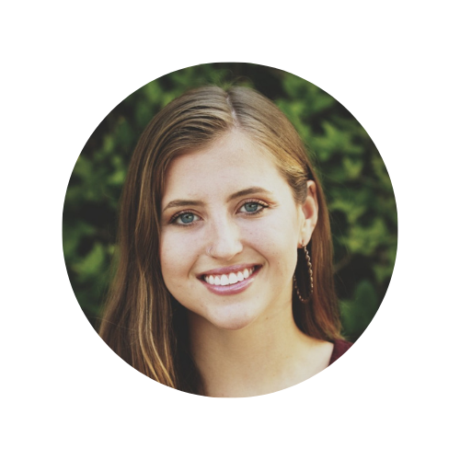
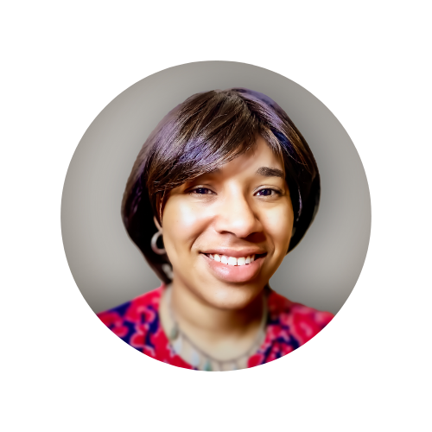
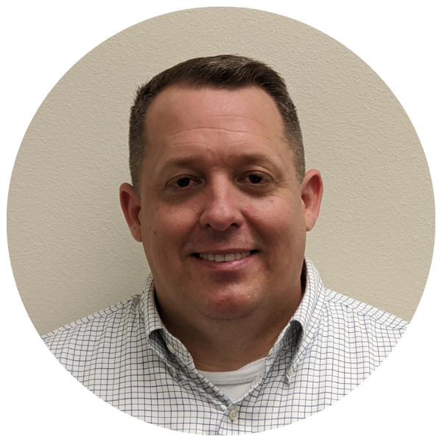
Introductions
David Canova
Workday Implementation Lead
Mika Garcia
Knight Vision Communications Analyst
Jacqueline Lewis
Training Lead
3

Slide 4
What is Workday?

Slide 5
at UCF
Workday will be the new Enterprise Resource Planning(ERP) system changing administrative process across the University.
Workday will Go Live in July 2022, for all Human Resources, Payroll and Finance functions.
Workday Student is being evaluated for implementation as Phase 2.
Workday will replace multiple systems, including Page-Up, OASIS, NetSuite, Financial Edge, Power Plan, Great Plains and more.
Employees will use Workday to manage their personal info, time off and time worked, pay information, finance and reporting and procurement.
Notes:
Presenter: David Canova
Goal: High-level overview of the impact of Workday, replacement of PeopleSoft financials, cloud-based data, etc.
Message:

Slide 6
Why Workday?
Current State of HR & Finance Processes
Future State of HR & Finance Processes
UCF has grown at an incredible rate and is composed of a strong foundation of exceptional students, staff and faculty. For a university of this size, it’s necessary to implement modern technology that reflects our growth and innovation.
Notes:
Presenter: David
Metaphor: UCF is a Mercedes and currently, we’re pushing the Mercedes. Utilizing a lot of manual processes to get things done.
The Future State of UCF with Workday looks like driving UCF (the Mercedes) with more streamlined, automated processes that work hand-in-hand with a cloud-based system.

Slide 7
Impacts to the UCF Campus Community
Employee Self Service Functionality
Mobile-Friendly Requests and Approvals
Easily-Accessible Employee Data for Managers and Supervisors
A Larger Variety of Communication Options for Tasks & Notifications
Notes:
Presenter: David

Slide 8
Notes:
Presenter: David

Slide 9
Workday by Role

Slide 13
Preparing for Training

Slide 14
Workday Training Update
Development of Training Materials continues until end of March.
Release and Deliver Training with tenant access by May 1.
Upcoming training sessions will be provided via our Training Calendar.
How to stay informed on training updates?
Attend Workday Community Info Sessions (next on January 25)
Subscribe to Knight Vision newsletter
View video demos before training on our Microsoft Stream channel

Slide 16
Workday Swag Giveaway

Slide 17
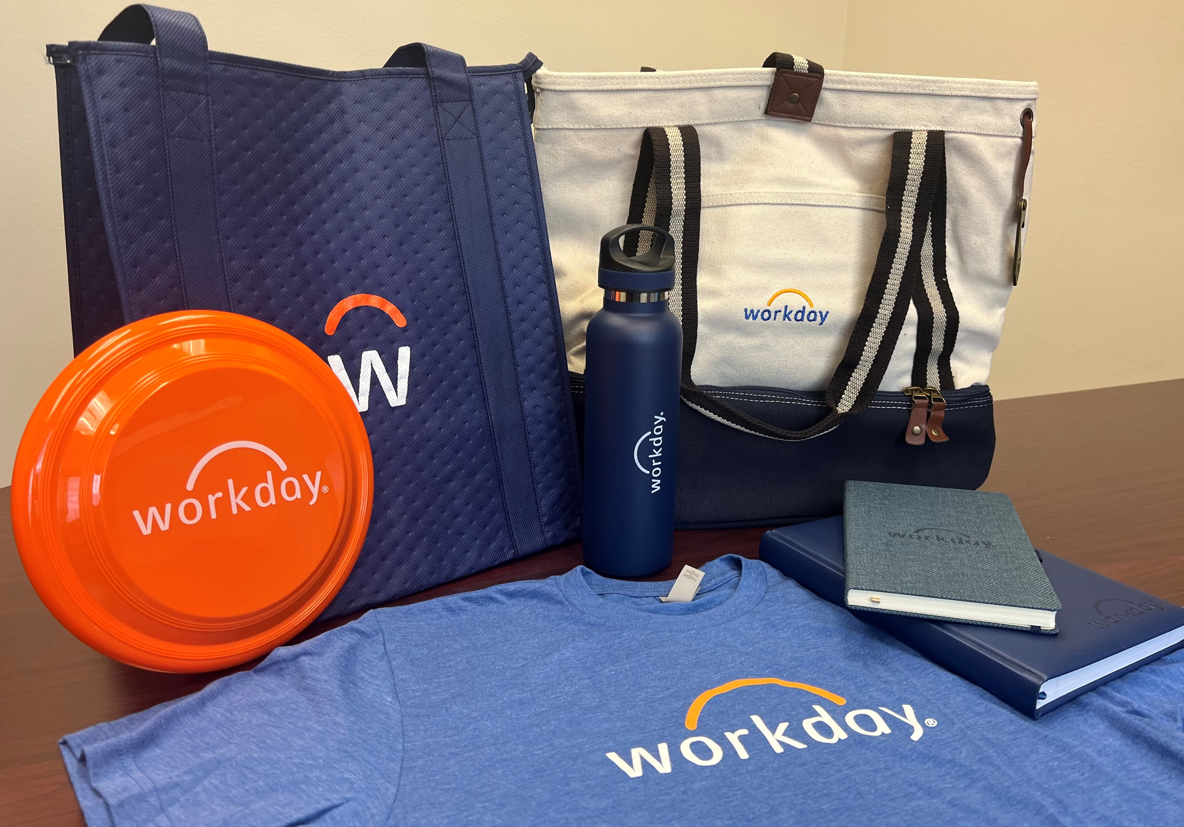
Giveaway Items
The three winners of this session’s giveaway will be randomly selected and contacted by the end of day. Each winner will receive one item.
Thank you for your participation!

Slide 18
Keep up to date by visiting the
Knight Vision website at knightvision.it.ucf.edu
Email: knightvision@ucf.edu
Subscribe to our newsletter:
https://tinyurl.com/KVNewsletterSubscription
Provide feedback:
https://tinyurl.com/KnightVisionFeedback
Participate in our virtual events and open forums:
knightvision.it.ucf.edu/get-involved

Slide 19
Thank you for your support!

